Slide 1
Numerical Computation for Deep Learning

Slide 2
Numerical concerns for implementations of deep learning algorithms
Algorithms are often specified in terms of real numbers; real numbers cannot be implemented in a finite computer
Does the algorithm still work when implemented with a finite number of bits?
Do small changes in the input to a function cause large changes to an output?
Rounding errors, noise, measurement errors can cause large changes
Iterative search for best input is diﬃcult

Slide 3
Roadmap
Iterative Optimization
Rounding error, underflow, overflow

Slide 4
Iterative Optimization
Gradient descent
Curvature
Constrained optimization

Slide 5
Gradient Descent
2.0
1.5
Global minimum at x = 0. Since f ⁰ (x) = 0, gradient descent halts here.
1.0
0.5
0.0
For x < 0, we have f ⁰ (x) < 0, so we can decrease f by moving rightward.
For x > 0, we have f ⁰ (x) > 0,
so we can decrease f by moving leftward.
—0.5
—1.0
—1.5
f (x) =
1 _{x}2
2
f ⁰(x) = x
1.0 1.5
—2.0
—0.5 0.0
x
—2.0
—1.5
—1.0
0.5
2.0
Figure 4.1

Slide 6
Approximate Optimization
This local minimum performs nearly as well as the global one,
so it is an acceptable
halting point.
f (x)
Ideally, we would like to arrive at the global minimum, but this might not be possible.
This local minimum performs poorly and should be avoided.
x
Figure 4.3

Slide 7
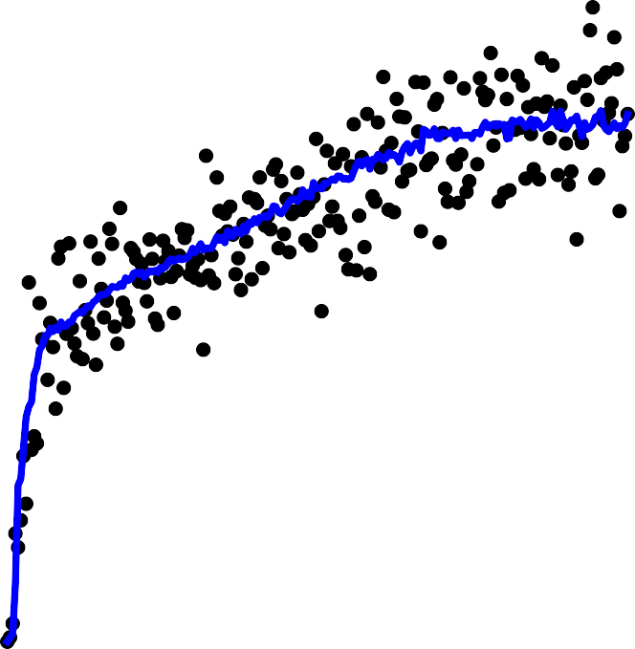
We usually don’t even reach a local minimum
16
14
12
10
8
6
4
2
0
1.0
0.9
0.8
0.7
0.6
0.5
0.4
0.3
0.2
0.1
error rate
norm
Gradient
Classification
—2
—50 0 50 100 150 200 250
Training time (epochs)
50 100 150 200 250
Training time (epochs)
0

Slide 8
Deep learning optimization way of life
Pure math way of life:
Find literally the smallest value of f(x)
Or maybe: find some critical point of f(x) where the value is locally smallest
Deep learning way of life:
Decrease the value of f(x) a lot

Slide 9
Iterative Optimization
Gradient descent
Curvature
Constrained optimization

Slide 10


Critical Points
Minimum
Maximum
Saddle point
Figure 4.2

Slide 11
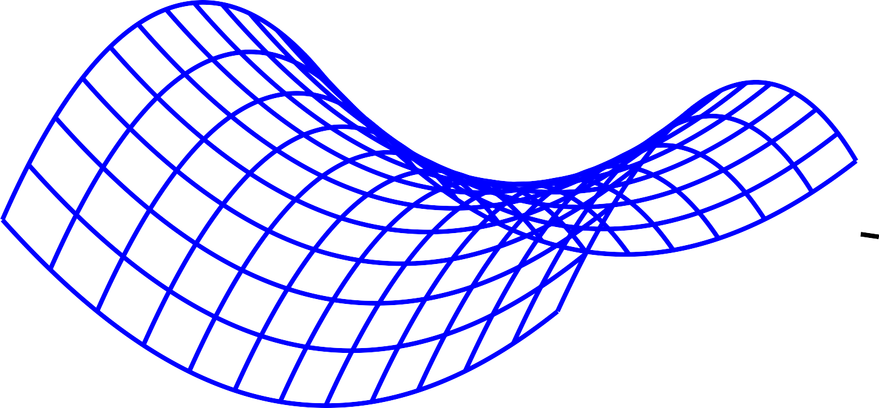
Saddle Points
500
0
−500
15
)
1
,x
1
f(x
−15
0
x
0
−15
1
x
15
Figure 4.5
1
(Gradient descent escapes, see Appendix C of “Qualitatively Characterizing Neural Network
Optimization Problems”)
Saddle points attract Newton’s method

Slide 12
Curvature
Negative curvature No curvature
Positive curvature
f (x)
f (x)
f (x)
x
x
Figure 4.4
x

Slide 13

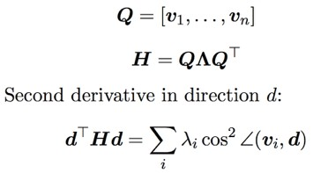
Directional Second Derivatives
Before multiplication After multiplication
3
3
_{¸1 v}(1)
2
2
1
_{v}(1)
1
_{v}(1)
x₁
0
_{x1}0
0
_{¸ v}(2)
_{v}(2)
2
_{v}(2)
−1
−1
−2
−3
−3 −2 −1 0 1
x₀
−2
2
3
−3
−3 −2 −1 0
_{x0}0
1
2
3

Slide 14
Predicting optimal step size using Taylor series
1
2
f(x⁽⁰⁾ — ✏g) ⇡ f(x⁽⁰⁾) —
>
2 >
✏g g +
✏ g Hg.
(4.9)
g>g
(4.10)
Big gradients speed you up
✏⇤ =
.
g>Hg
Big eigenvalues slow you down if you align with their eigenvectors
(Goodfellow 2017)

Slide 15
Condition Number
λ
i
max
i,j
. .
.
(4.2)
λ_{j}
When the condition number is large, sometimes you hit large eigenvalues and sometimes you hit small ones.
The large ones force you to keep the learning rate small, and miss out on moving fast in the small eigenvalue directions.

Slide 16
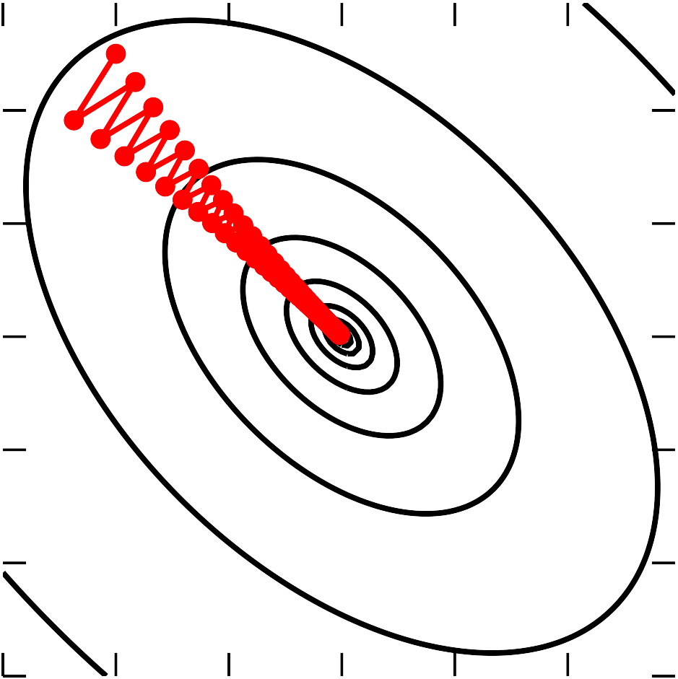
Gradient Descent and Poor Conditioning
20
10
0
—10
—20
x₂
—30
—30 —20 —10 0 10 20
x₁
Figure 4.6

Slide 17






Neural net visualization
At end of learning:
- gradient is still large
- curvature is huge
(From “Qualitatively Characterizing Neural Network Optimization Problems”)

Slide 18
Iterative Optimization
Gradient descent
Curvature
Constrained optimization

Slide 19
KKT Multipliers
X
X
min max max —f(x) + λ g
(i)
(x) +
↵ h
(j)
(x).
(4.19)
x
i
j
Z ↵,↵≥0
i
j
In this book, mostly used for
theory
(e.g.: show Gaussian is highest entropy distribution)
In practice, we usually just project back to the
constraint region after each step

Slide 20
Roadmap
Iterative Optimization
Rounding error, underflow, overflow

Slide 21
Numerical Precision: A deep learning super skill
Often deep learning algorithms “sort of work”
Loss goes down, accuracy gets within a few percentage points of state-of-the-art
No “bugs” per se
Often deep learning algorithms “explode” (NaNs, large values)
Culprit is often loss of numerical precision

Slide 22
Rounding and truncation errors
In a digital computer, we use float32 or similar schemes to represent real numbers
A real number x is rounded to x + delta for some small delta
Overflow: large x replaced by inf
Underflow: small x replaced by 0

Slide 23
Example
Adding a very small number to a larger one may have no eﬀect. This can cause large changes downstream:
>>> a = np.array([0., 1e-8]).astype('float32')
>>> a.argmax() 1
>>> (a + 1).argmax() 0

Slide 24
Secondary eﬀects
Suppose we have code that computes x-y
Suppose x overflows to inf
Suppose y overflows to inf
Then x - y = inf - inf = NaN

Slide 25
exp
exp(x) overflows for large x
Doesn’t need to be very large
float32: 89 overflows
Never use large x
exp(x) underflows for very negative x
Possibly not a problem
Possibly catastrophic if exp(x) is a denominator, an argument to a logarithm, etc.

Slide 26
Subtraction
Suppose x and y have similar magnitude
Suppose x is always greater than y
In a computer, x - y may be negative due to rounding error
^{Safe} Dangerous
(3.12)
Example: variance
Var(f (x)) = E ^{h}(f(x) — E[f(x)])^{2i}
.
2
= E f(x)² — E [f(x)]

Slide 27
log and sqrt
log(0) = - inf
log(<negative>) is imaginary, usually nan in software
sqrt(0) is 0, but its derivative has a divide by zero
Definitely avoid underflow or round-to-negative in the argument!
Common case: standard_dev = sqrt(variance)

Slide 28
log exp
log exp(x) is a common pattern
Should be simplified to x
Avoids:
Overflow in exp
Underflow in exp causing -inf in log

Slide 29
Which is the better hack?
normalized_x = x / st_dev
eps = 1e-7
Should we use
st_dev = sqrt(eps + variance)
st_dev = eps + sqrt(variance) ?
What if variance is implemented safely and will never round to negative?

Slide 30
log(sum(exp))
Naive implementation:
tf.log(tf.reduce_sum(tf.exp(array))
Failure modes:
If any entry is very large, exp overflows
If all entries are very negative, all exps underflow… and then log is -inf

Slide 31
Stable version
mx = tf.reduce_max(array) safe_array = array - mx
log_sum_exp = mx + tf.log(tf.reduce_sum(exp(safe_array))
Built in version:
tf.reduce_logsumexp

Slide 32
Why does the logsumexp trick work?
Algebraically equivalent to the original version:
X
m + log exp(a — m)
i
i
X
exp(a )
= m + log
i
exp(m)
i
1 exp(m)
X
= m + log
exp(a )
i
i
X
= m — log exp(m) + log
exp(a )
i
i

Slide 33
Why does the logsumexp trick work?
No overflow:
Entries of safe_array are at most 0
Some of the exp terms underflow, but not all
At least one entry of safe_array is 0
The sum of exp terms is at least 1
The sum is now safe to pass to the log

Slide 34
Softmax
Softmax: use your library’s built-in softmax function
If you build your own, use:
safe_logits = logits - tf.reduce_max(logits) softmax = tf.nn.softmax(safe_logits)
Similar to logsumexp

Slide 35
Sigmoid
Use your library’s built-in sigmoid function
If you build your own:
Recall that sigmoid is just softmax with one of the logits hard-coded to 0

Slide 36
Cross-entropy
Cross-entropy loss for softmax (and sigmoid) has both softmax and logsumexp in it
Compute it using the logits not the probabilities
The probabilities lose gradient due to rounding error where the softmax saturates
Use tf.nn.softmax_cross_entropy_with_logits or similar
If you roll your own, use the stabilization tricks for softmax and logsumexp

Slide 37
Bug hunting strategies
If you increase your learning rate and the loss gets stuck, you are probably rounding your gradient to zero somewhere: maybe computing cross-entropy using probabilities instead of logits
For correctly implemented loss, too high of learning rate should usually cause explosion

Slide 38
Bug hunting strategies
If you see explosion (NaNs, very large values) immediately suspect:
log
exp
sqrt
division
Always suspect the code that changed most recently

Slide 39
Questions

